Slide 1
Sisters Landmarks

Slide 2
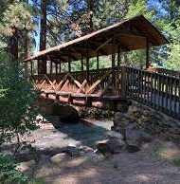
Creekside Bridge
What Landmark is this?

Slide 3
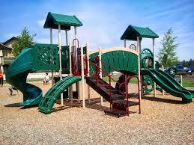
Village Green City Park
What Sisters Landmark is this?

Slide 4
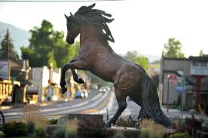
Bronze Horse Statue Main Street Sisters
What Landmark is this?

Slide 5
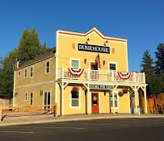
Sisters Bunkhouse
What Landmark is this?

Slide 6
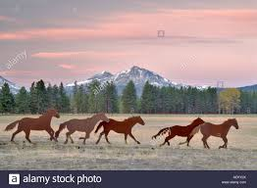
Running Horses Sculpture
What Sisters Landmark is this?

Slide 7
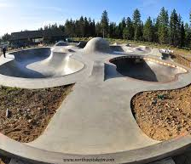
Sisters Skate Park
What Landmark is this?

Slide 8
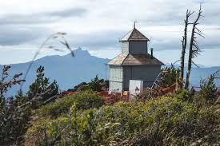
Black Butte Fire Lookout
What Landmark is this?

Slide 9
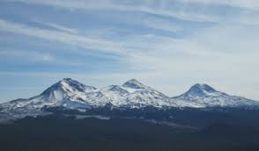
Three Sisters
What Mountains are these?

